Slide 1

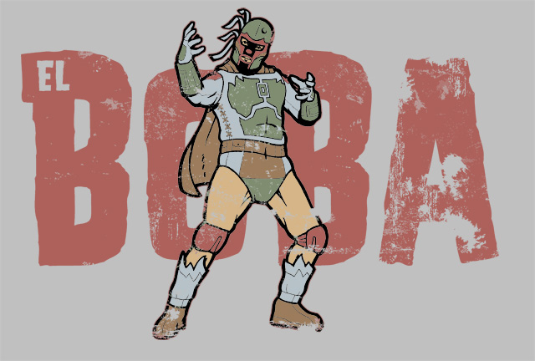

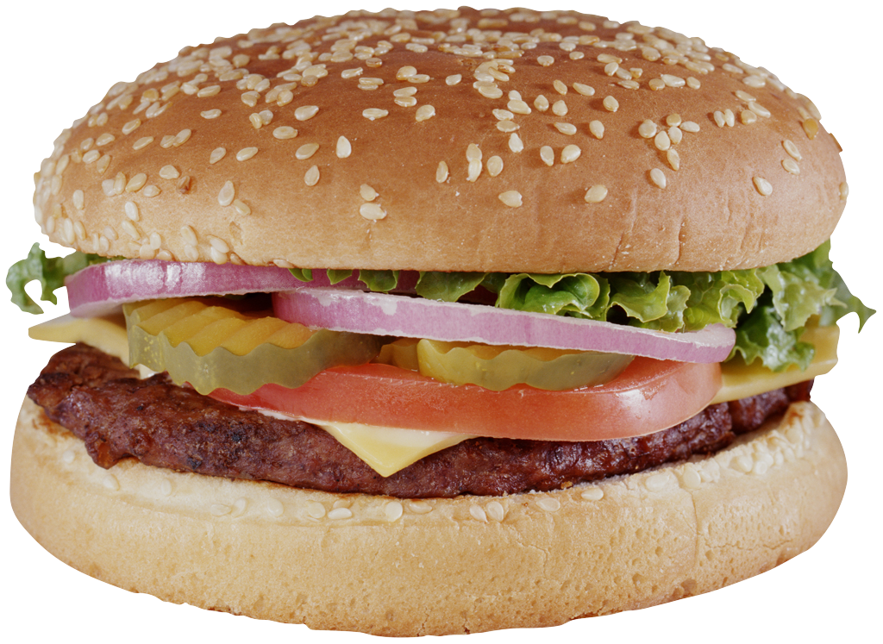
The key is to go to ‘format picture’ and then crop to fit.
COMICS
Adding things is easy. You could build a template for kids to use.

Slide 2
Bottom text field with handwriting font (Anime Ace 2.0)

